Slide 1
Time-series Generative Adversarial Networks
Kunnskap for en bedre verden
Claus Martinsen
Notes:
In this paper, the authors tries to solve the problem of creating a model for generating Time Series data, and present their solution TimeGAN.

Slide 2
Motivation
GANs (2014)
Two NNs, a generator and a discriminator.
Generating realistic data
Creating images, music, training data for ML, even prediction
Time-series are important and everywhere
We should have good generative models for TS
Notes:
- To explain the motivation, I have to explain GANs. Concieved in 2014.
- GANs consist of two parts, a generator and a discriminator.
- The generator tries to generate realistic outputs such that the discriminator cant tell the difference between its outputs and a real sample. Tries to fool the discriminator.
- The discriminator on its end tries to guess the fake generated samples from the real ones.
- In this process the generator learns to generate new data with the same characteristics as the training set. I.e when training on picures, it learns to generate photorealistic images.
- The motivation for GANs is to generate realistic data, and has since its inception been used in a wide variety of fields. An example is medical data, for ML. This can often be infeasible to share bco. privacy. Sufficently realistic, synthetically generated data might be an alternative.
- As we have come to realize, Time series are everywhere and important.
- We should have good generative models for TS

Slide 3
Problem
What is a good generative model for TS data?
Generated data must be realistic over time.
GANs have typically struggled
Should keep the same relationships between features over time as the real data.
Notes:
- Brings me to the problem
- A field where the generative models have struggled are Time Series data.
- We want to generate realistic TS data
- Should not only learn to generate realistic features for a single time-point, but accross time. As we know, the present very much depends on the past.
- This is where the GAN-approach have typically failed.
- A sample produced by a GAN, i.e. the temprature and humidity in Trondheim at a spesific timepoint should not only be realistic in itself, but also realistic with respect to the last sample produces, i.e. the temp. and hum. an hour ago.
- Another way to rephrase this is that the generative model should keep the same relationships between the features over time as the real data.

Slide 4
Related work
Autoregressive recurrent neural networks
Deterministic, cannot sample random sequences
Not suited for the generative task
GANs using RNNs
C-RNN-GAN, RCGAN are two such implementations
Uses LSTMs for generator and discriminator
Representation learning and autoencoders
Notes:
- In TS, we typically use autoregressive models for when we need to generate a prediction or forcast consisting of multiple steps where the newer steps depend on the prediction of the earlier.
- The fundamental problem with these models are that they are not generative in the sense that you can sample random new sequences. They are deterministic, and will give the same output each time.
- In another aproach to this problem, GANs have been used with RNN for generator and discriminator.
- Two such examples are C-RNN-GAN, RCGAN, using LSTM networks for generator and discriminator.
- One might think that this solves the problem since RNNs can learn temporal relationships, but a central problem is that the generator is only trained using binary feedback from the discriminator, which may not be enough to learn the temporal relationships of the features.
- Imagine trying to learn to generate an realistic, fake weather forecast, and simply getting a "yes" or "no" answer after you submit your attempt.
- Another subject in TS is that of representation learning, or that instead of learning from the original features directly, you learn from a set of fewer, compound features that are a sort of compression of the original features. This has been show to have certain benefits that I wont go into detail about nown other than that is is related to the field of autoencoders.

Slide 5
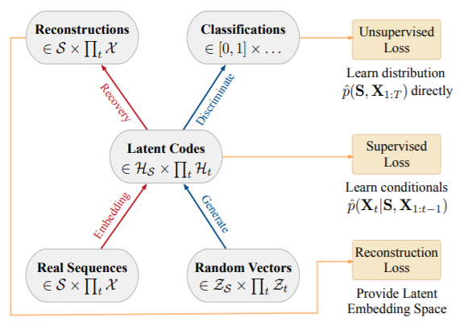
Method
TimeGAN
4 NN components
Embedding
Recovery
Generator
Discriminator
Two forms of training
GAN-style training
Supervised training
Notes:
- Their proposed model: TimeGAN.
- Consists of four NN components.
- The first two networks are basicly an encoder and a decoder that translates to and from the original feature space to a smaller one (like an autoencoder). They call these networks the embedding and recovery networks.
- Within this embedded feature space that is the outputs of the embedding network operates the two last networks, the GAN generator and discriminator. So the generator learns to produce outputs in this embedded feature space, which then is translated to the real feature space using the recovery network.
- They chose to implement the embedding network as an RNN and the recovery network as a FF NN, for simplicity.
- The generator takes in a vector representing the state at the previous timestep, and tries to produce the state at the next timestep.
- During training, to address the typical problem of GANs with TS they train the generator in two modes. And this is really the core of their findings:
- The first mode is the typical GAN-style training where the loss is computed from the result of the discriminators binary feedback. In this mode, the generator recieves its own prevoius previous outputs as inputs in an autoregressive manner to calculate the next synthetic state.
- In the other mode, which is your more typical supervised learning approach, the generator is fed real data, and a loss is calculated based on the accuracy of the synthetic, generated next state.

Slide 6
Experimental setting
Three qualities
Diversity
Fidelity
Usefullness
Test on both artificial datasets and real datasets
Stock prices, energy consumption, cancer treatment
Compare to both GAN-based and other models
Notes:
- The authors describe three qualities they evaluate the generated data on:
- Diversity, "it sould be distributed to cover the real data". This is evaluated by using dimentionality reducing techniques PCA and t-SNE and visually confirming the overlap.
- Fidelity, "it should be indistinguishable from the real data". This is evaluated by training a separate classification model for distinguishing beween the real and synthetic data, in a task equivalent to the discriminator.
- Usefulness, "should be just as useful as the real data" for use, i.e. if a model is trained on fake data, it should be able to score accuratly when tested on real data. This is evaluated by training a model on the generated data and measuring the performance in terms of mean absolute error.
- They do these experiments both on artificial datasets, and real data sets such as stock prices, energy consumption, and cancer treatment.
- They compare TimeGAN to both to the other GAN-based models i talked about earlier, as well as other methods.

Slide 7
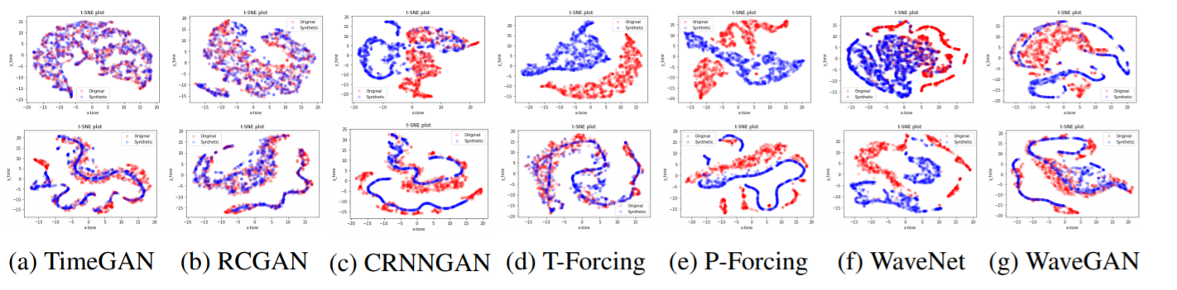
Results
Diversity
Overlaps well
Notes:
- For measuring the diversity, they observe visually that the generated data overlaps very well with the real data. Here you can see TimeGAN and how it overlaps compared to the other models. They describe TimeGAN as having significantly better overlap than the rest.

Slide 8
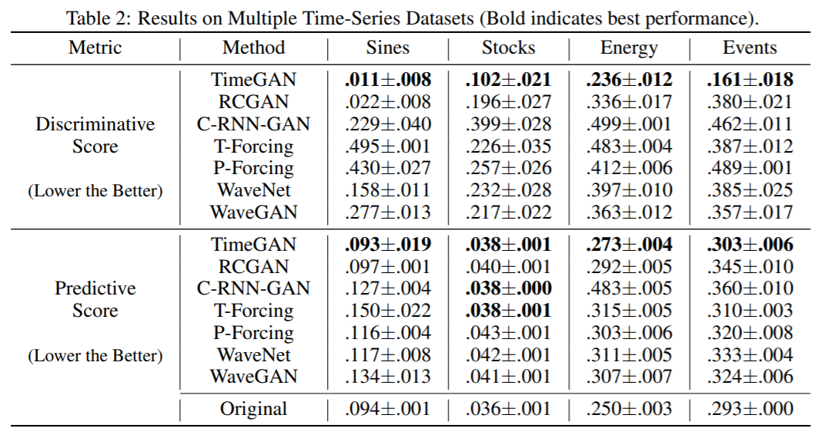
Results
Fidelity (discriminative score)
Usability (predictive score)
Achieves better (or as good as) results than the State of the Art
In some cases significantly better
Notes:
- When it comes to testing the fidelity and usefullness they find, as is described in this table, that their model performs as good or better than the SOTA across the board. In some cases, such as the task to create indistinguishable Stock-data, the gain is very significant. 48% in this case.

Slide 9
Conclusion
TimeGAN
Combines GAN, supervised learning and encoder-decoder.
Allows the generator to learn relationships over time
Produces higher quality synthetic data
Notes:
- In this paper the authors propose TimeGAN, a model for generating Time Series data that combines the traditional GAN approach with the supervised learning approach and an encoder-decoder-like network to allow the generator to learn the relationships between the features over time.
- They try their model on both artificial and real datasets and find that their model produces higher-quality synthetic data compared to the SOTA.

Slide 10
Own thoughts
Enjoyed learning about GANs
May be of relevance to my own thesis
Truly open source:
https://bitbucket.org/mvdschaar/mlforhealthlabpub/src/master/alg/timegan/
TensorFlow-model
Jupyter Notebook
Code for generating synthetic TS and replicating the results
Notes:
Overall I enjoyed this paper, it was relatively reader-friendly written and it was interesting learning more in-depth about GANs.
It may also be of relevance to my own thesis.
I also appreciated that the project is truly open source, with a well documented code repository with the model implemented in TensorFlow, as well at a tutorial in the form of a Jupyter notebook and code for replicating the results and generating your own synthetic Time Series.

